Slide 1




ML Project Workshop 1
Davis Data Science Club
ML Overview
Python
Visualizations

Slide 2
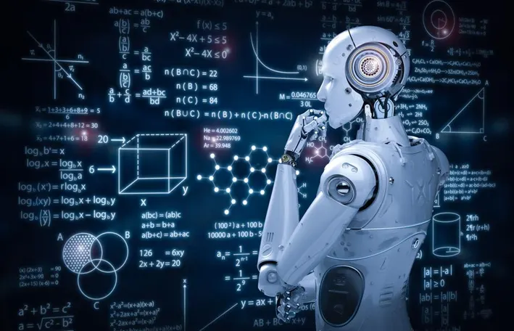
What will we be doing?
2 part project workshop!
Part 1 (Today - 05/01):
Overview of ML
Introduction to data
Set Up
EDA
Part 2 (Week 7 - 5/15):
Modeling - Train and Test
Algorithms
Accuracy

Slide 3
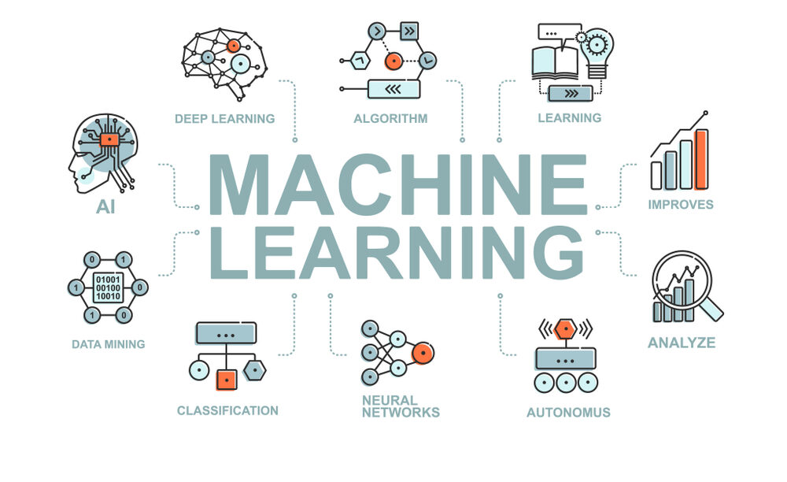
Machine Learning
What is it and why is it important?
Branch of AI - uses data and algorithms to learn, not explicitly programmed!
Fast way to create models to analyze and assess data sets
Key Steps:
Prepare data/pick an algorithm
Train/test model
Assess accuracy
Optimize model

Slide 4
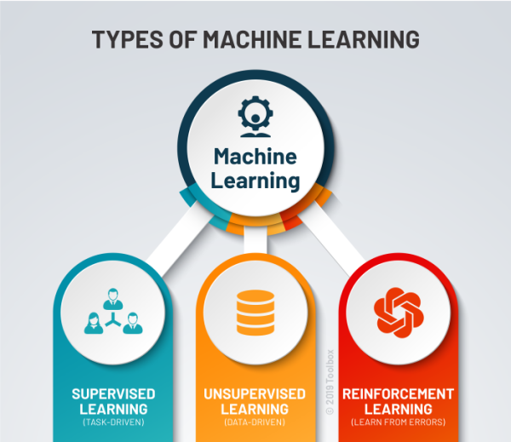
3 Main Types of ML
Supervised learning
Takes input and output of past data to train models
Ex) credit card fraud detection
Unsupervised learning
Less obvious patterns
Takes input of data, various pieces of information, without the output to make predictions or classify patterns
Ex) creating customer groups based on purchase behavior
Reinforcement learning
Most similar to how humans learn
Reward and punishment
Ex) self-driving cars
Notes:
https://www.coursera.org/articles/types-of-machine-learning

Slide 5
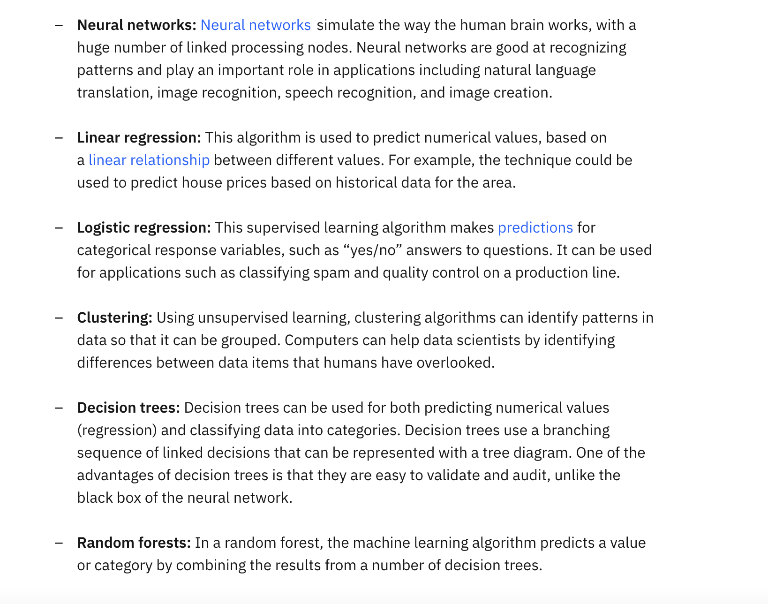
Common ML Algorithms: Overview

Slide 6

Common ML Algorithms

Slide 7
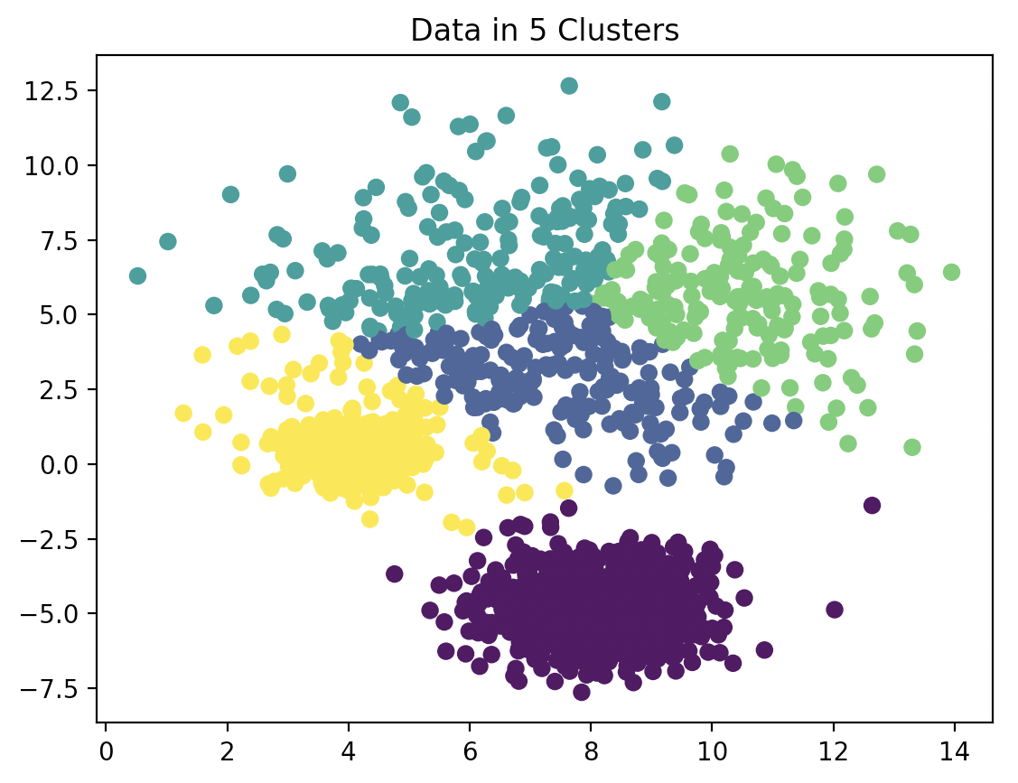
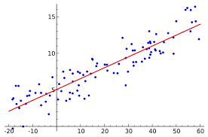
Common ML Algorithms: Clustering and Regression

Slide 8
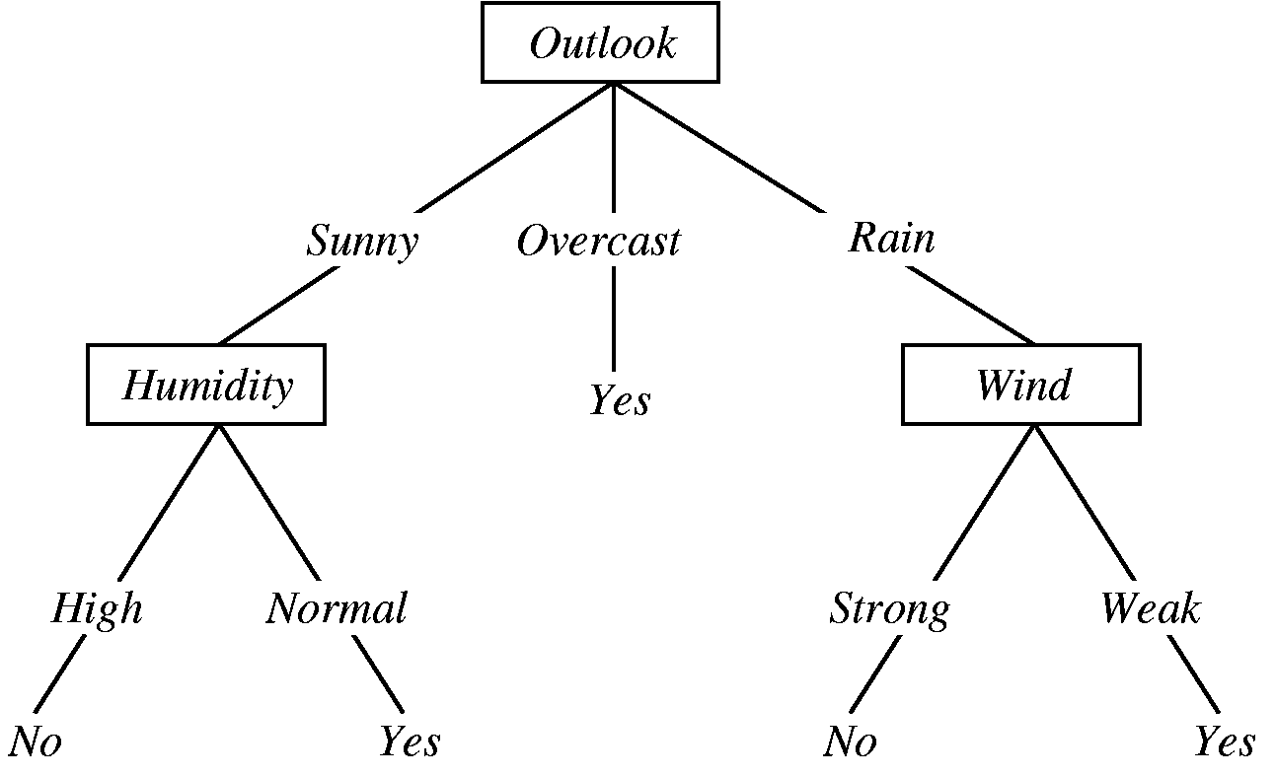
Common ML Algorithms: Decision Trees

Slide 9
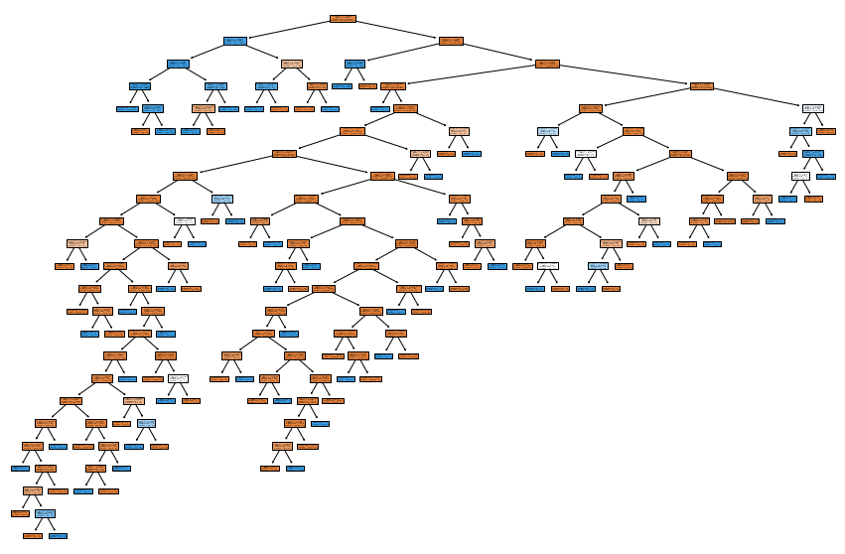
Common ML Algorithms: Decision Trees

Slide 10
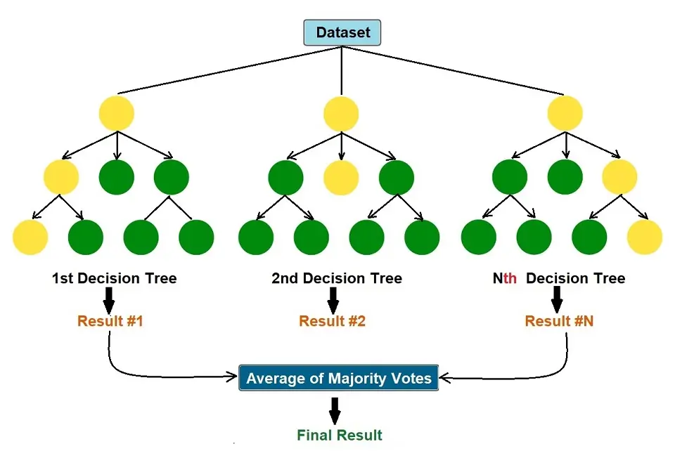
Common ML Algorithms: Random Forest

Slide 11
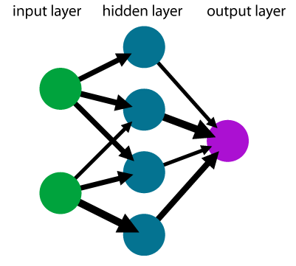
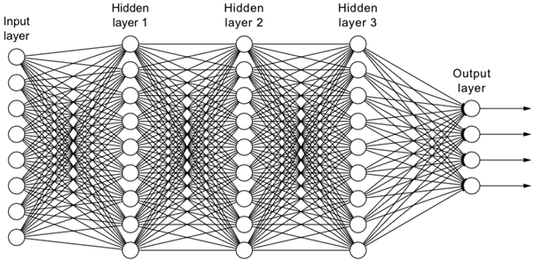
Common ML Algorithms: Neural Networks

Slide 12
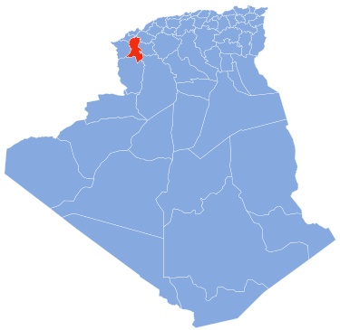
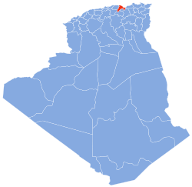
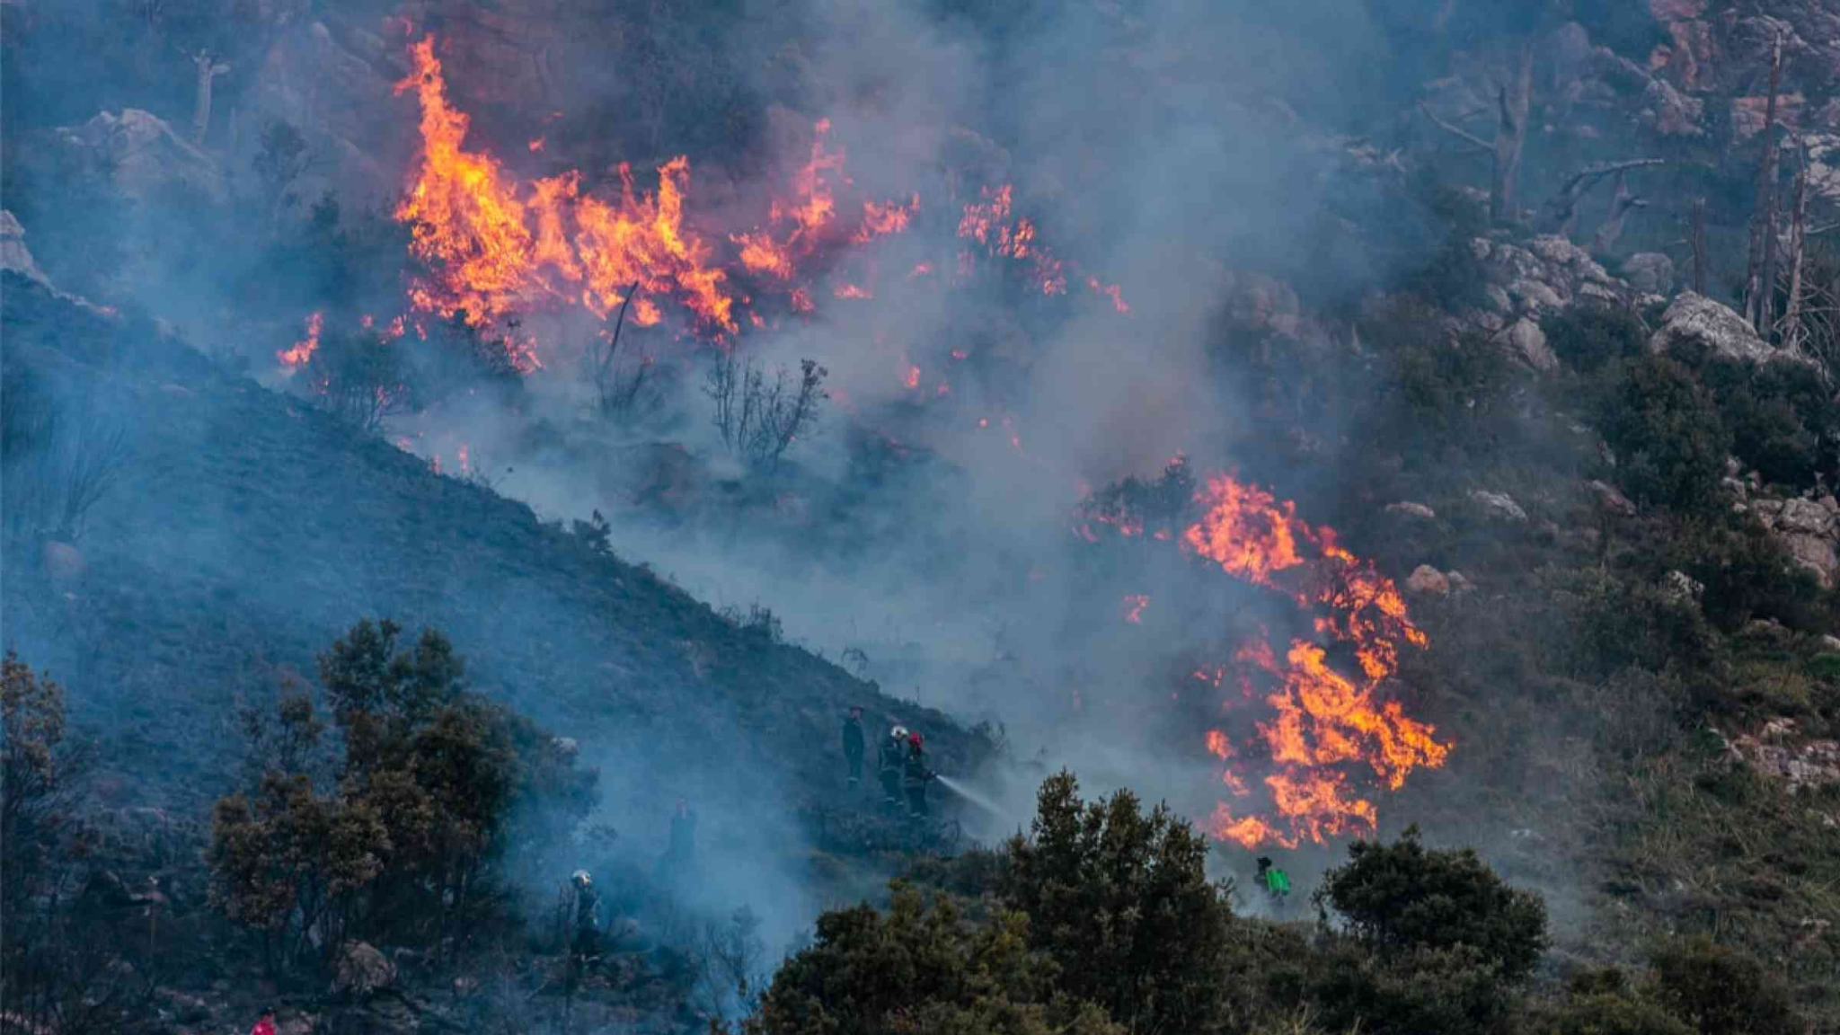
Project: Algerian Forest Fires
How can we predict the likelihood of forest fires given weather observations?
Sidi Bel-abbes
Bejaia
2012

Slide 13
About the Data
Date : (DD/MM/YYYY) Day, month ('june' to 'september'), year (2012) Weather data observations
Temp : temperature noon (temperature max) in Celsius degrees: 22 to 42
RH : Relative Humidity in %: 21 to 90
Ws :Wind speed in km/h: 6 to 29
Rain: total day in mm: 0 to 16.8 FWI Components
Fine Fuel Moisture Code (FFMC) index from the FWI system: 28.6 to 92.5
Duff Moisture Code (DMC) index from the FWI system: 1.1 to 65.9
Drought Code (DC) index from the FWI system: 7 to 220.4
Initial Spread Index (ISI) index from the FWI system: 0 to 18.5
Buildup Index (BUI) index from the FWI system: 1.1 to 68
Fire Weather Index (FWI) Index: 0 to 31.1
Classes: two classes, namely Fire and not Fire
Notes:
The dataset includes 244 instances that regroup a data of two regions of Algeria,namely the Bejaia region located in the northeast of Algeria and the Sidi Bel-abbes region located in the northwest of Algeria.
122 instances for each region.
The period from June 2012 to September 2012. The dataset includes 11 attribues and 1 output attribue (class) The 244 instances have been classified into fire(138 classes) and not fire (106 classes) classes

Slide 14
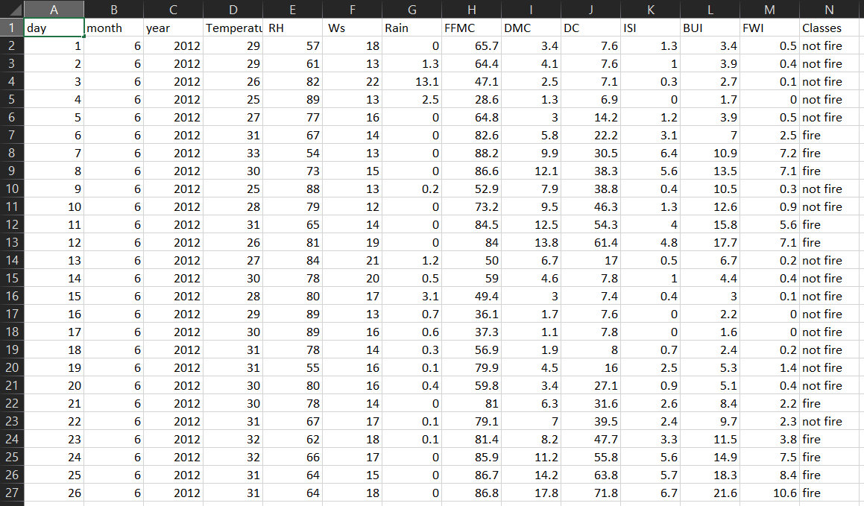
About the Data
Notes:
122 instances for each region.
The period from June 2012 to September 2012. The dataset includes 11 attribues and 1 output attribue (class) The 244 instances have been classified into fire(138 classes) and not fire (106 classes) classes

Slide 15
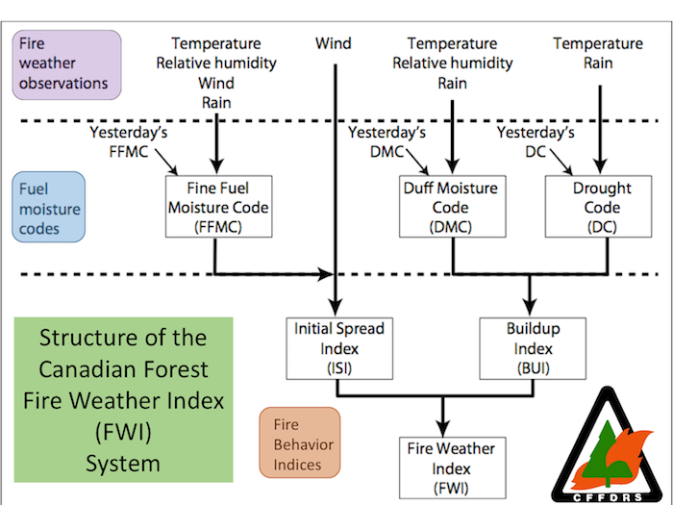
Fire Weather Index

Slide 16

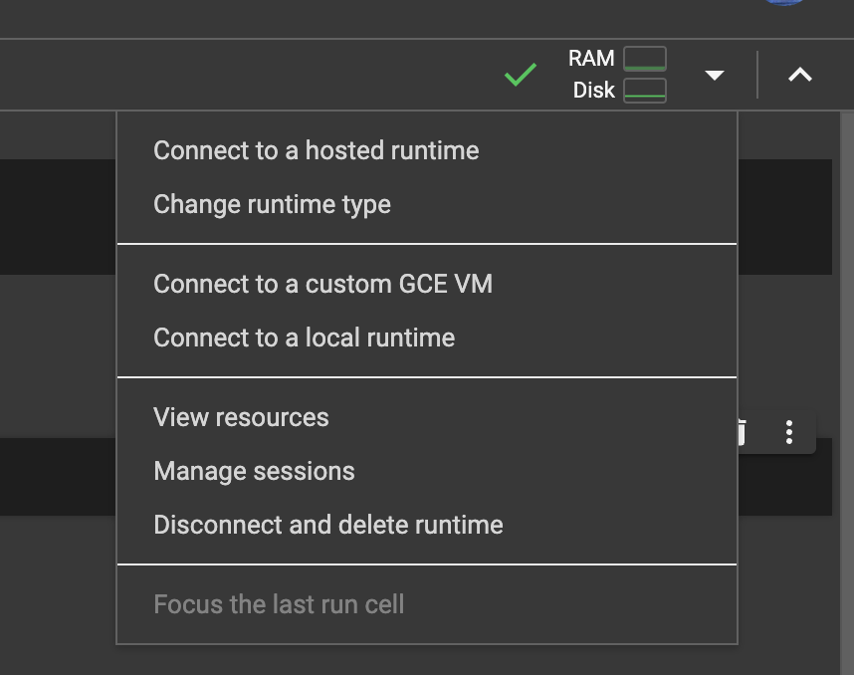
Google Colab
Google Colab: https://colab.google/
Default language should be Python3
To change to R:
Go to the down arrow next to RAM and Disk
Click on change runtime type
Then select R
Link to notebook to follow along: https://tinyurl.com/p3mjfdtd
(Need to make a copy if you want to save it)
(Also sent in the discord)
Notes:
Change run

Slide 17
Resources!
More about ML - https://ischoolonline.berkeley.edu/blog/what-is-machine-learning/
ML Course for beginners - https://tinyurl.com/mvv2b3t2
EDA - https://towardsdatascience.com/a-gentle-introduction-to-exploratory-data-analysis-f11d843b8184
Seaborn tutorial - https://www.datacamp.com/tutorial/seaborn-python-tutorial

Slide 18

Thank you!
IG: @data.ucd
FB: facebook.com/data.ucd
Website: davisdsc.com
GitHub: Davis-Data-Science-Club
Discord: discord.gg/zCPRKHdM7
Linktree: linktr.ee/davisdsc
Notes:
QR code in case ppl need to sign in
https://linktr.ee/davisdsc
https://discord.gg/zCPRKHdM7
www.davisdsc.com
www.facebook.com/data.ucd

Slide 19
Link to notebook - https://colab.research.google.com/drive/1CL73eiIrPtgPvC4XIxQ5no5qMdbiAuCK?usp=sharing
Real word examples/ applications of ml
Types of ML
Types of algorithms
What we’ll cover in part 1 versus part 2
Google colab set up
Pandas library
https://www.kaggle.com/datasets/sudhanshu432/algerian-forest-fires-cleaned-dataset
https://www.kaggle.com/code/sudhanshu432/eda-and-fe-algerian-forest-fires-dataset
https://www.kaggle.com/code/sudhanshu432/algerian-forest-fires-prediction-regressions

Slide 20
Explain what we’ll be doing and why and how - machine learning, python, libraries, vectorization, cnn
introduce the project and data
clean/transform data?
EDA & visualizations

